Slide 1
PROJECT REPORT (PROJECT TERM JUNE-JULY
2024)
Reinforcement Learning For Video
Game Sales
Submitted By:- Indukuri Sai Gowtham Reddy
Reg.No-12210219
Mail :-gowthamleo43351@gmail.com

Slide 2
Table of Contents:-
Title-………………………………………………………….1 Introduction-………………………………………….3-4 Literature review-…………………………………5-15 Methadology-…………………………………….16-20 Coding-…………………………………………………21-24 Result&Output-………………………………….25-31 Future Scope-…………………………………….32-34
References-………………………………………..35-37

Slide 3
List Of Illustrations & Tables
Fig-1.1-Table of Dataset Genres Fig -1.2-Table of DataSet Values Fig-1.3-Table of Missing Values
Fig-1.4-Table of Null & Missing Values
Fig-1.5-Table of Info & Categorised Values
Fig-2.1-Visualisation of Genres using Countplot Xticks
Fig-2.2-Pairwise correlation Of the VideoGame Sales Features Fig-2.3-Video Games Sales Over The Years
Fig-2.4-Plots for Video Games Sales in Millions Fig-2.5-Sales PieChart

Slide 4
DECLERATION
I here by declare that the project work entitled “Reinforcement Learning for Video games” is an authentic record of my own work carried out as requirements of Project for the award of B. Tech degree in Computer Science and Engineering from Lovely Professional University, Phagwara, under the guidance of IBM,during June to July 2024. All the information furnished in this project report is based on my own intensive work and is genuine.
Indukuri Sai Gowtham Reddy 12210219
9th JULY 2024

Slide 5
ACKNOWLEDGMENT
I would like to acknowledge the support and help of IBM who always encouraged me in this research. Without his constant guidance and help, this project would not have been successful for me. I am grateful to the beautiful IBM and Department of Artificial Intelligence without whom this project would not have been an achievement. I also thank my family and friends for their endless love and support throughout my life.

Slide 6
INTRODUCTION:-
In an era marked by the digital revolution, the video game industry is a testament to innovation and creativity, enchanting audiences around the world with immersive experiences and interactive storytelling. Amidst the ever- evolving landscape of gaming platforms and technological advancements, understanding the complex dynamics behind video game success has become a formidable endeavor. Our machine learning project embarks on a journey into the heart of this dynamic industry and aims to unlock the mystery of video game sales through data insight and predictive analytics.At the core of our project is a treasure trove of data. It comes from multiple sources and contains countless features that give a vivid picture of the gaming market. From game titles to their genres, platforms, release dates and sales results in different regions, this dataset is a rich trove of information waiting to be explored and analyzed. Since each record represents a unique story in the ever-evolving story of the video game industry, our project aims to extract meaningful patterns and trends hidden in this vast repository of data.Our company's main goal is to harness the power of machine learning. . algorithms that interpret background patterns that drive video game sales. Through predictive modeling and algorithmic analysis, we seek to uncover the complex interplay of factors such as genre, platform and release time, and shed light on the elusive formula for success in the competitive environment of the games market. By

Slide 7
distilling complex data into actionable insights, our project aims to provide stakeholders with the information they need to make informed decisions and make strategic interventions in game development, marketing and distribution.In addition, our project aims to go beyond the superficial. A level of analysis that explores the nuances of regional preferences, cultural influences and emerging trends shaping the global video game market. Using advanced analytics and visualization techniques, we strive to unravel the dynamics driving consumer behavior and market demand, providing a nuanced understanding of the diverse and ever-changing preferences of gamers around the world.Moving into the complexity of the real world. . data, our project faces the data pre-processing and quality challenges head-on, ensuring the integrity and reliability of our analyses.Through careful cleaning, transformation and validation processes, we strive to maintain the highest standards of data integrity, thus creating a strong foundation for meaningful insights and actionable recommendations.Our machine learning project is fundamentally a pioneering effort to unlock the secrets of information security. . for the video game industry, combining the art of storytelling with the science of data analysis. As we embark on this journey of exploration and discovery, we invite you to uncover the secrets that lie beneath the surface of the digital frontier and that will shape the future of gaming for years to come.

Slide 8
Literature Review: Predictive Modeling for Video Game Sales
The tool is designed to support company management in defining expected sales figures. Neural networks trained with a back propagation algorithm are used to predict the weekly sales of a video game[1]. The final result is a graphically representable structure or set of structures that opens up space for further and alternative exploration of the plot. Such visualization can also be useful during the ongoing annotation process. Manually annotating songs can be difficult, and the ability to annotate directly in the text provided by Brat's annotation tool doesn't seem useful enough. In this article, we propose Brat2Viz, a tool and pipeline for displaying annotated narrative visualization in Brat[14]. A player's preferences and abilities can be determined in a number of different ways, but should be done as discreetly as possible to immerse the player. This article examines how recorded gameplay in a me-person shooter game can predict a player's abilities. Since these features were able to model the player's skill with 76%

Slide 9
accuracy without using game-specific features, we believe their use is transferable to similar games in the genre[3]. Data mining is the process of extracting hidden information from databases. Clustering is one of the important functions of data mining Clustering is an adaptive methodology in which objects are grouped together based on the principle that optimizes intra-class similarity and minimizes inter-class similarity. Various clustering algorithms have been developed, resulting in better performance for clustering datasets[5]. Computer game data mining is a new data mining method that helps develop games according to the player's requirements and interests. Since the gambling industry has contributed a large amount to the income of the countries, the improvement of this sector becomes essential. The purpose of this research is to apply data mining techniques such as association, classification and clustering to improve game design, marketing and monitoring of game stickiness to improve game quality[2]. Therefore, many machine learning techniques have been invented for this purpose. In this paper, we try to predict retail sales using various machine

Slide 10
learning techniques and try to determine the best algorithm that fits the given problem description[6]. The goal is to analyze the sales of major game models and predict their future sales, which will help them increase their profits and make their brand even better and more competitive according to market trends, creating customer satisfaction[8]. The database contains various aspects of social games. Rules based on association analysis would be of immense benefit to the game industry as they can use them to optimize game design features[9]. Penetration rate is the primary measure of overall surface TBM performance and is\used to assess machine feasibility and predict excavation progress. The purpose of thisstudy is to develop a regression model to predict the penetration rate[11]. Meeting these challenges requires relevant, reliable and actionable games data (Arrouays et al., 2014) at local, national and global scales[10]. The dilemma between oversampling and achieving maximum accuracy is rarely resolved. A method is proposed to build a decision tree- based classifier that maintains the highest accuracy in the training data and improves the generalization accuracy as it increases with increasing complexity[13].

Slide 11
Methodology
The predictive modeling method for video game sales is a structured process designed to ensure that accurate and reliable models are developed according to ethical standards. The main steps of this method are described below. This method describes the basic steps involved in collecting, processing and analyzing data to create predictive models for video game sales.
Data Collection:-
In the initial phase of the methodology, data required for training are collected and predictive models are tested. This includes obtaining historical data on video game sales and related attributes such as genre, platform, release date, marketing spend, user reviews and demographics. Data sources can vary, including publicly available data repositories, APIs provided by game platforms, or direct collaboration with publishers and developers. The first step of the method is data collection, which involves collecting different data sets related to forecasting the sales of video games. These data sets may include historical sales data, game features, marketing strategies, user reviews and demographic information. Data sources can vary, including sales databases maintained by game platforms, publicly available data repositories and market research reports. Ensuring the quality, consistency and representativeness of the data collected is essential to building reliable forecasting models.
Data Preprocessing:-
Once the data is gathered, it undergoes preprocessing to ensure its quality and suitability for modeling purposes. This preprocessing stage involves handling missing values, outliers, and inconsistencies through techniques such as imputation, normalization, and encoding of categorical variables. Additionally, the data is partitioned into training, validation, and test sets to facilitate unbiased model evaluation.This phase involves several preprocessing steps, including handling missing

Slide 12
values, detecting and treating outliers, and normalizing numerical features. Categorical variables are encoded using techniques such as one-hot encoding or label encoding to make them suitable for modeling. Additionally, feature scaling techniques like standardization or min-max scaling are applied to ensure that all features contribute equally to the model.
Feature Engineering:-
Feature engineering plays a crucial role in enhancing the predictive capabilities of the models. In this step, relevant attributes are selected and transformed to improve model performance. This may involve creating new features based on existing ones, scaling numerical features, and encoding categorical variables. Dimensionality reduction techniques, such as feature selection, are also applied to focus on the most informative features.Following data collection, the collected data undergoes preprocessing to clean, transform, and organize it for analysis. This phase involves several preprocessing steps, including handling missing values, detecting and treating outliers, and normalizing numerical features. Categorical variables are encoded using techniques such as one-hot encoding or label encoding to make them suitable for modeling. Additionally, feature scaling techniques like standardization or min-max scaling are applied to ensure that all features contribute equally to the model.
Model Selection:-
Following feature engineering, appropriate predictive models are selected for training. A range of models is considered, including traditional statistical methods like linear regression and time series forecasting, as well as machine learning algorithms such as decision trees, random forests, support vector machines, and neural networks. The selection criteria prioritize models capable of handling the complexity of the data and capturing nonlinear relationships effectively.Once the data is preprocessed and engineered, the next step is to select appropriate predictive models. The choice of models depends on factors such as the nature of the problem (regression or

Slide 13
classification), the size and complexity of the dataset, and the desired level of interpretability. Commonly used models include linear regression, decision trees, random forests, gradient boosting machines (GBMs), support vector machines (SVMs), and neural networks. Ensemble methods, which combine multiple base models to improve predictive performance, are often preferred for their robustness and flexibility.
Model Training and Evaluation:-
The selected models are then trained on the training data using optimization techniques such as gradient descent or backpropagation. Hyperparameters are tuned using methods like grid search or random search to optimize model performance. Subsequently, the trained models are evaluated using suitable evaluation metrics such as mean absolute error, mean squared error, or accuracy, depending on the problem type (regression or classification). Model evaluation is performed on the validation set to identify the best-performing model for deployment.Following model selection, the chosen models are trained on the preprocessed dataset using appropriate training algorithms. During the training phase, model parameters are optimized to minimize the chosen loss function, typically through techniques like gradient descent or stochastic gradient descent. Following training, the models are evaluated using validation data to assess their performance and generalization ability. Various evaluation metrics such as mean absolute error (MAE), root mean square error (RMSE), accuracy, precision, recall, and F1-score are computed to gauge model performance across different domains.
Validation and Testing:-
Once the best-performing model is identified, it undergoes validation on the test set to assess its performance in real-world scenarios. This validation process involves deploying the model on unseen data and comparing its predictions against ground truth values. Additionally,

Slide 14
cross-validation techniques such as k-fold cross-validation or leave- one-out cross-validation may be employed to assess model stability and variability.After evaluating the models on the validation set, the best-performing model(s) are further validated on a separate test set to assess their performance in real-world scenarios. This step ensures that the model's performance observed during training and validation is indicative of its ability to make accurate predictions on unseen data. Cross-validation techniques, such as k-fold cross-validation, may also be employed to assess model stability and variability.
Ethical Considerations:-
Throughout the methodology, ethical considerations are carefully addressed to ensure the responsible development and deployment of predictive models. This includes safeguarding data privacy and security, mitigating bias in model predictions, and maintaining transparency in all stages of model development. Adherence to ethical guidelines and regulations, such as GDPR and CCPA, is fundamental to safeguarding user rights and fostering trust in predictive models. Furthermore, efforts are made to mitigate algorithmic biases by carefully selecting features, monitoring model predictions for fairness, and implementing bias detection and mitigation techniques. Transparency and accountability are maintained by documenting the entire modeling pipeline, including data sources, preprocessing steps, model selection criteria, and evaluation metrics.

Slide 15
CODING:-
import numpy as np; import pandas as pd ;
import matplotlib.pyplot as plt;
import seaborn as sns;
Data_Set =
pd.read_csv("C:\\Users\\I.SAI
GOWTHAM
REDDY\\Downloads\\vgsales.csv (1).zip"); Data_Set;
Data_Set.head(); Data_Set.tail(); Data_Set.isnull().sum();
Data_Set=Data_Set.dropna(); Data_Set;
Data_Set.isnull().sum();
Data_Set.duplicated(); Data_Set.info(); Data_Set.describe(); Data_Set.columns;
Data_Set['Year']=pd.to_datetime(Data_Set['Year']); Data_Set.info();
Data_Set['Genre'].value_counts();
data= pd.read_csv("C:\\Users\\I.SAI
GOWTHAM
REDDY\\Downloads\\vgsales.csv (1).zip");
sns.countplot(y='Genre',data=data,order=data['Genre'].value_coun ts().index);

Slide 16
plt.xticks(rotation=80);
numeric_columns = data.select_dtypes(include=['float64', 'int64']);
correlation_matrix = numeric_columns.corr();
plt.figure(figsize=(12, 10));
sns.heatmap(correlation_matrix, fmt=".3f");
annot=True, cmap='coolwarm',
plt.title("Pairwise Correlation of the Video Game Sales Features"); plt.show();
plt.figure(figsize=(12, 6));
sns.lineplot(data=data, palette='tab10');
plt.xlabel('Year');
x='Year', y='Genre', hue='Genre',
plt.ylabel("Sales (in millions)");
plt.title("Video Games Sales Over the Years");
plt.legend(title='Sales Category', loc='upper left'); plt.grid(True);
plt.show();
Data_Set['Year'] = pd.to_numeric(Data_Set['Year'], errors='coerce');
plt.figure(figsize=(12, 6));

Slide 17
bar_width = 0.2;
index = Data_Set['Year'].unique();
bar_positions = [index - 2 * bar_width, index - bar_width, index, index + bar_width, index + 2 * bar_width];
plt.bar(bar_positions[0],
Data_Set.groupby('Year')['NA_Sales'].sum(), bar_width, label='NA Sales');
plt.bar(bar_positions[1],
Data_Set.groupby('Year')['EU_Sales'].sum(), bar_width, label='EU Sales');
plt.bar(bar_positions[2], Data_Set.groupby('Year')['JP_Sales'].sum(), bar_width, label='JP Sales');
plt.bar(bar_positions[3],
Data_Set.groupby('Year')['Other_Sales'].sum(), label='Other Sales');
plt.bar(bar_positions[4],
Data_Set.groupby('Year')['Global_Sales'].sum(), label='Global Sales');
bar_width,
bar_width,
plt.xlabel('Year');
plt.ylabel('Sales (in millions)');
plt.title('Video Game Sales Over the Years'); plt.xticks(index, rotation=45);
plt.legend(); plt.grid(True);
plt.tight_layout();

Slide 18
plt.show();
area_sales = Data_Set[["NA_Sales","EU_Sales", "JP_Sales",
"Other_Sales"]]; area_sales
area_sales.melt(var_name='Area',value_name='Total_Sales');
area_sales
area_sales.groupby('Area')['Total_Sales'].sum().reset_index();
=
=
plt.figure(figsize=(15,10));
plt.pie(area_sales['Total_Sales'],labels=area_sales['Area'],colors=sn s.color_palette('magma_r'),autopct='%.2f%%');
plt.show();

Slide 19
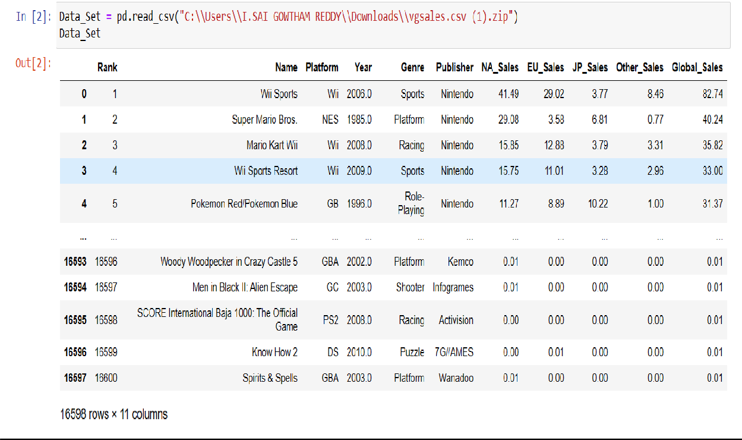
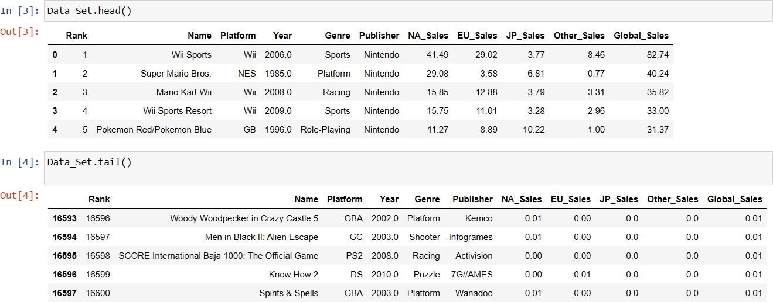
Result & Output:-
Fig-1.1-Table of Dataset Genres
Fig 1.2-Table of Data Sets Values

Slide 20
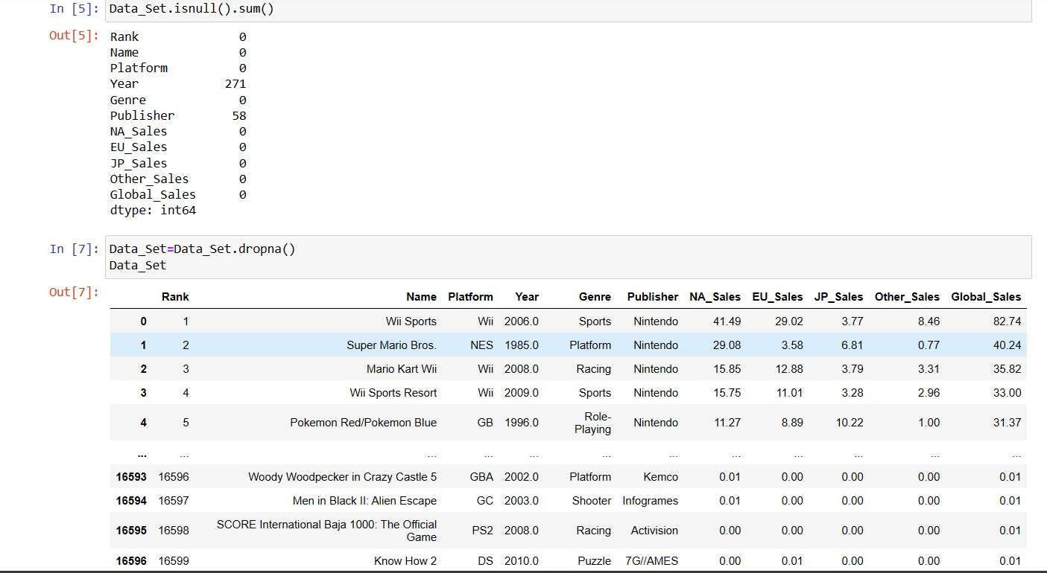
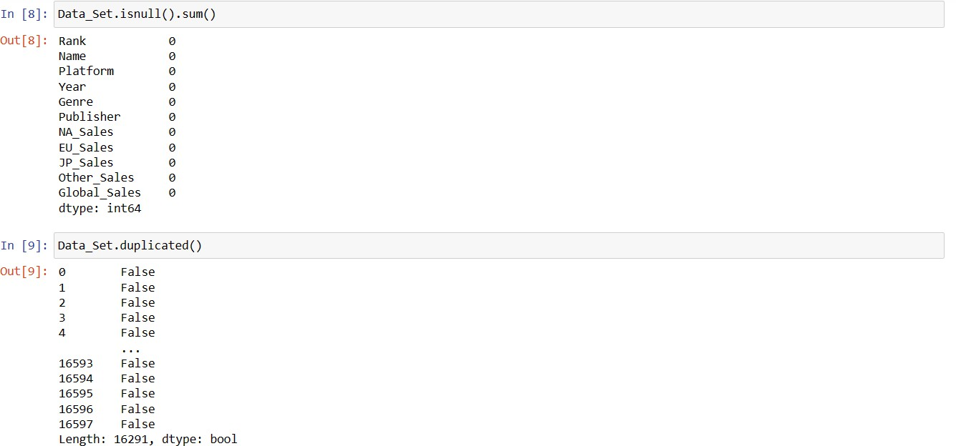
Fig 1.3 Table of Missing Values
Fig-1.4-Table of Null & Missing Values

Slide 21
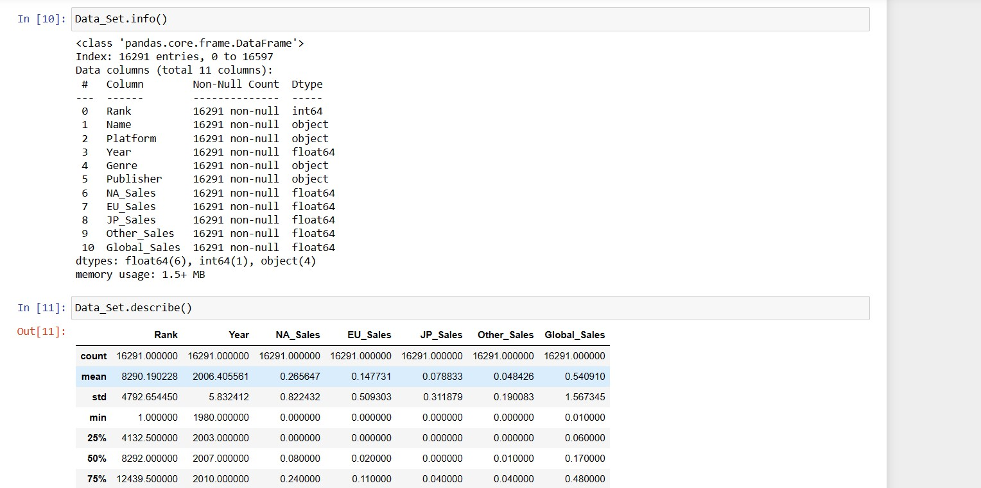
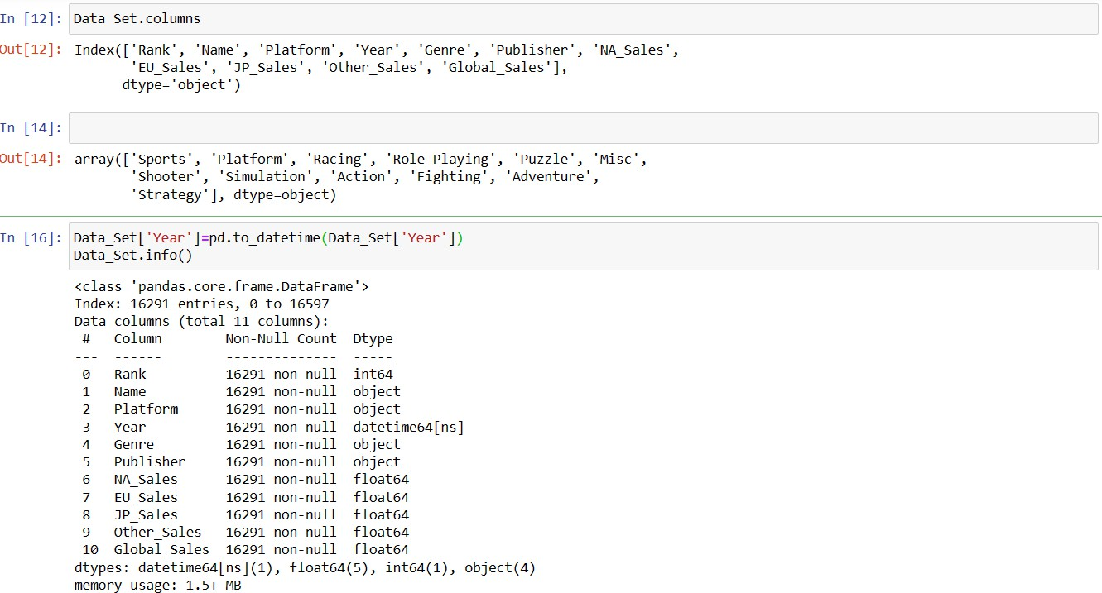
Fig-1.5-Table of Info & Datatype of the Categorization Values

Slide 22
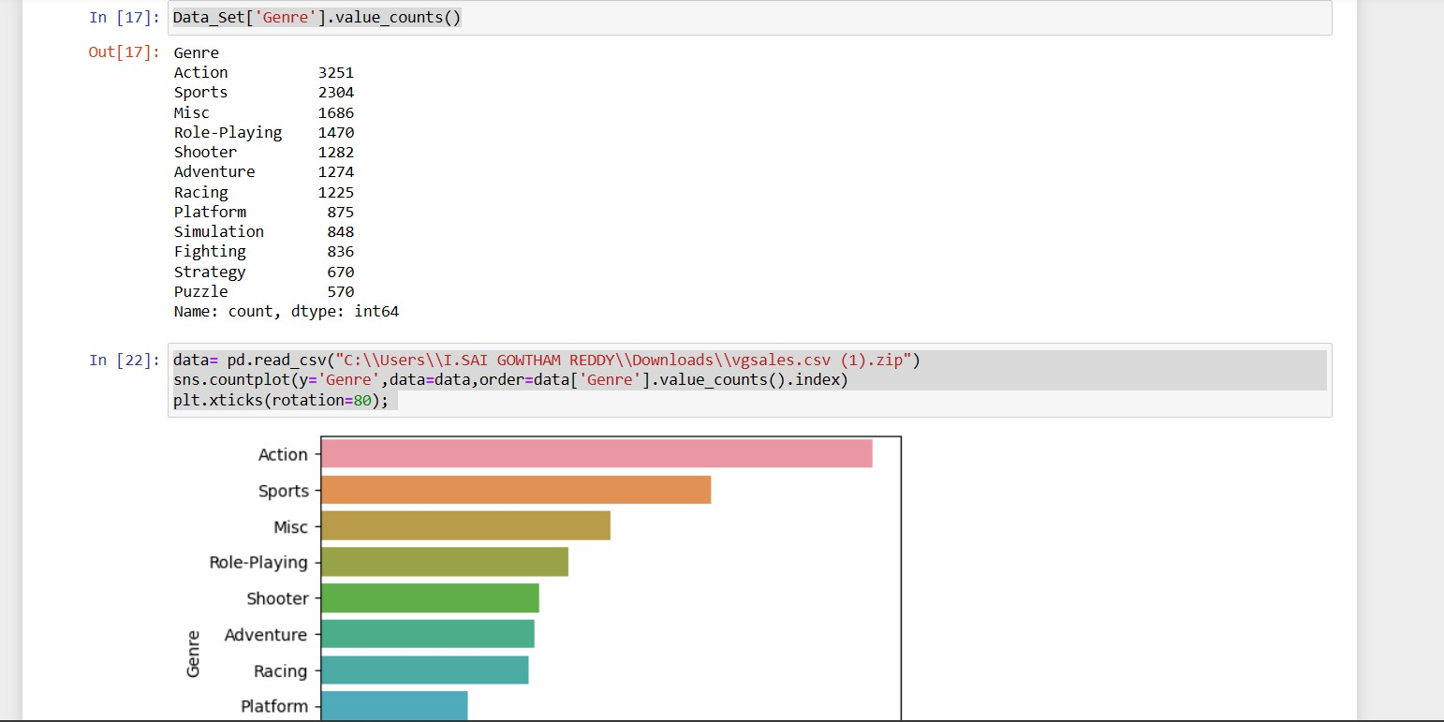
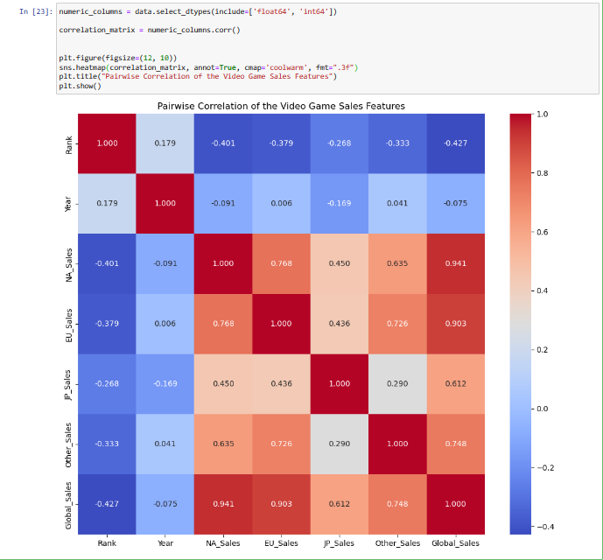
Fig-2.1-Visualisation of Genres using Countplot Xticks
Fig-2.2-Pairwise correlation Of the Video Game Sales Features

Slide 23
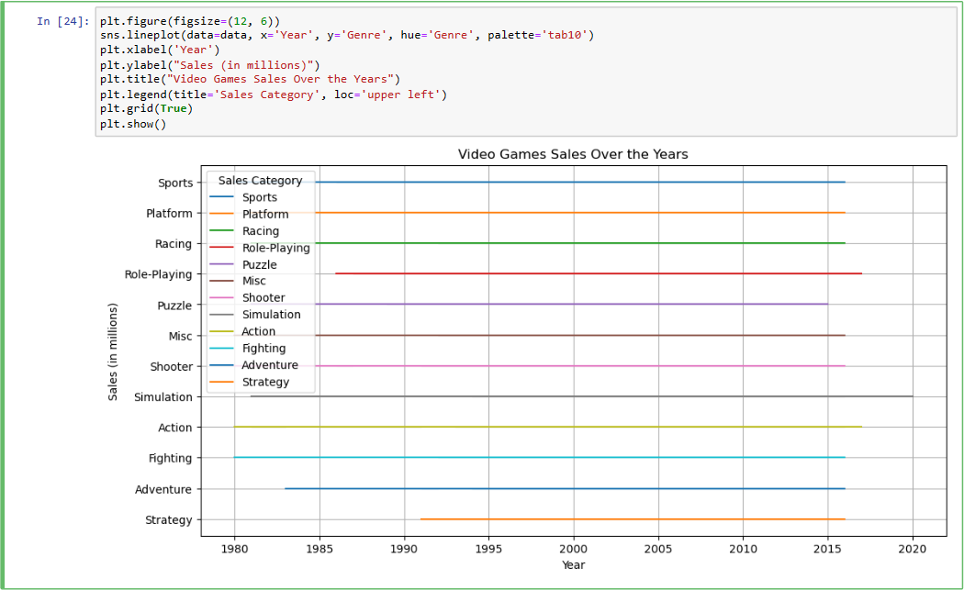
Fig-2.3-Video Games Sales Over The Years

Slide 24
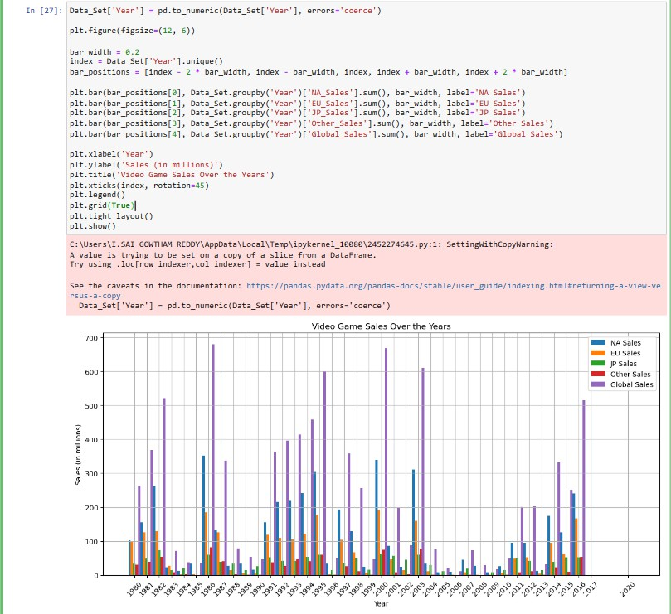
Fig-2.4-Plots for Video Games Sales in Millions Over the Years

Slide 25
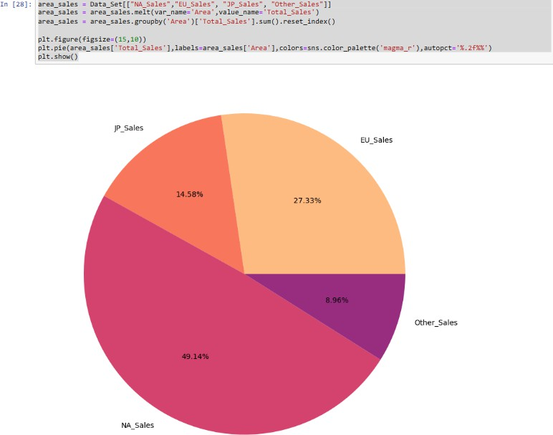
Fig-2.5-Sales PieChart

Slide 26
Observation:-
The implementation of the prescribed methodology for predictive modeling of video game sales unveils crucial insights into the intricacies of the gaming industry. Through the meticulous execution of each procedural step, several noteworthy observations come to light:
Data Integrity is Paramount: The efficacy of predictive modeling heavily hinges upon the quality of the data amassed. It is evident that ensuring data integrity, encompassing factors like completeness, consistency, and accuracy, stands as a cornerstone for constructing dependable predictive models. Any lapses in data quality could introduce biases or inaccuracies, thereby undermining the efficacy of the modeling endeavor.
Feature Engineering Drives Predictive Precision: Feature engineering emerges as a pivotal facet of the methodology, empowering researchers to distill meaningful insights from raw data. Observations underscore that well-crafted features, derived from both domain expertise and data-driven methodologies, substantially augment the predictive prowess of models. By integrating pertinent features such as temporal trends, user sentiments, and engagement metrics, models can aptly encapsulate the nuances inherent in video game sales dynamics.
Model Selection and Evaluation are Iterative Endeavors: The process of model selection and evaluation unfolds as iterative undertakings, guided by empirical evidence and domain acumen. It becomes apparent that delving into a spectrum of modeling techniques and evaluation metrics is imperative to discern the most apt model for a given predictive task. Iterative refinements, rooted in validation and testing outcomes, serve to refine model performance and bolster its generalization capacity.

Slide 27
Ethical Considerations Drive Decision-making: Ethical considerations permeate every facet of the modeling process, exerting a substantial influence on decision-making protocols. Observations underscore that prioritizing data privacy, transparency, and fairness is pivotal to upholding the ethical integrity of predictive models. Adherence to ethical precepts and regulatory frameworks fosters trust and accountability within the modeling realm, underpinning the cultivation of responsible AI practices in the gaming domain.
Validation Validates Model Robustness: Validation and testing protocols serve as pivotal litmus tests, gauging the robustness and generalization efficacy of predictive models. It becomes evident that scrutinizing model performance across independent test sets engenders confidence in the model's aptitude to furnish accurate predictions in real-world contexts. Cross-validation methodologies further fortify the reliability and resilience of models, affording insights into their adaptability across diverse datasets.
In summation, the observations gleaned from the application of the methodology for predictive modeling of video game sales underscore the cardinal significance of data integrity, feature engineering, model selection, ethical considerations, and validation methodologies. Embracing these observations empowers researchers and practitioners to craft robust, precise, and ethically defensible predictive models, thereby propelling informed decision-making and fostering sustainable growth within the gaming sector.

Slide 28
Future Scope:-
The application of the outlined methodology for predictive modeling of video game sales not only provides valuable insights into the present landscape but also illuminates promising avenues for future exploration and development. Several areas emerge as potential focal points for further research and innovation, ensuring the continued advancement of predictive modeling in the gaming industry while maintaining ethical standards:
Comprehensive Data Integration: Future research endeavors could delve into more extensive data integration strategies, incorporating a diverse array of data sources such as player behavior data, streaming platform analytics, and virtual reality interactions. By amalgamating heterogeneous datasets, researchers can gain deeper insights into player preferences, engagement patterns, and market trends, thereby refining the predictive capabilities of models to anticipate future sales trends more accurately.
Advancements in Model Architectures:There exists significant potential for exploring advanced model architectures, particularly within the domain of deep learning. Further research into convolutional neural networks (CNNs) and recurrent neural networks (RNNs) could unlock new avenues for modeling sequential data, sentiment analysis of user reviews, and image recognition tasks within the gaming domain. Such architectures hold promise for capturing intricate patterns and nuances inherent in video game sales dynamics, thereby enhancing predictive accuracy.
Integration of Explainable AI (XAI): The integration of explainable AI (XAI) techniques presents an exciting direction for future research endeavors. By elucidating the decision-making processes of complex

Slide 29
models, XAI methods such as feature importance analysis, SHAP values, and model-agnostic interpretability approaches can enhance transparency and trust in predictive models. This fosters greater interpretability and understanding of model predictions, facilitating stakeholder buy-in and adoption while mitigating concerns regarding opaque AI systems.
4.Dynamic Modeling Frameworks: Given the dynamic nature of the gaming industry, there is a pressing need for dynamic modeling frameworks capable of adapting to evolving trends and market conditions in real-time. Future research could focus on developing dynamic modeling approaches, such as time-varying parameter models and adaptive learning algorithms. Such frameworks would enable more accurate and responsive sales predictions, empowering stakeholders to make timely decisions in a rapidly changing market landscape.
5.Multi-Modal
Data Fusion:Exploring multi-modal data fusion
techniques offers significant potential for enriching predictive modeling endeavors within the gaming industry. By integrating textual, visual, and gameplay data, researchers can construct more holistic models that capture diverse aspects of the gaming experience. This comprehensive approach, encompassing sentiment analysis of user reviews, image recognition for genre classification, and fusion of gameplay metrics, provides a nuanced understanding of player preferences and behavior, thereby enhancing the granularity of predictive models.
6. User-Centric Personalization: The pursuit of user-centric personalization represents a promising avenue for future research and

Slide 30
innovation. By leveraging machine learning techniques such as collaborative filtering and content-based recommendation systems, developers can tailor gaming experiences to individual player preferences and demographics. This not only enhances player satisfaction and engagement but also fosters long-term loyalty and revenue generation within the gaming ecosystem.
7. Cross-Domain Knowledge Transfer: Drawing insights from related industries such as film, music, and literature offers an invaluable opportunity for cross-domain knowledge transfer. Future research endeavors could explore parallels between these domains, uncovering common patterns and trends that may inform video game sales prediction strategies. Interdisciplinary collaborations and knowledge exchange initiatives can facilitate innovation and the cross-pollination of ideas, enriching predictive modeling practices within the gaming industry.
In conclusion, the future scope for predictive modeling of video game sales is replete with opportunities for innovation and advancement. By embracing emerging technologies, refining modeling methodologies, and fostering interdisciplinary collaborations, researchers can unlock new frontiers in understanding consumer behavior, predicting market trends, and driving sustainable growth within the dynamic landscape of the gaming industry, all while ensuring the integrity and ethical responsibility of predictive modeling practices.

Slide 31
References:-
Marcous, J., & Selouani, S.-A. (2008). A hybrid subspace- connectionist approach for sales forecasting in the video game industry. IEEE.
Andrat, H., & Ansari, N. (2016). Integrating data mining with computer games. IEEE.
Buckley, D., Chen, K., & Knowles, J. (2013). Predicting skill from gameplay input to a first-person shooter. IEEE.
Zhang, J., & Li, J. (2016). Retail commodity sale forecast model based on data mining. IEEE.
Shrivastava, V. (2012). A study of clustering algorithms on retail sales data.
Krishna, A., & V, A. (2018). Sales forecasting for retail stores using machine learning techniques. IEEE.
Bertens, P., & Guitart, A. (2017). Games and Big Data: A Scalable Multi-Dimensional Churn Prediction Model. IEEE.
Gopalakrishnan, T., Choudhary, R., & Prasad, S. (2018). Prediction of sales value in online shopping using linear regression. IEEE.
Ansari, N., Talreja, M., & Desai, V. (2012). Data mining in online social games. Springer India.
Alfons, A. (2012). cvTools: Cross-validation tools for regression models (Version 0.3.2). R package.
Mahdevari, S., Shahriar, K., Yagiz, S., et al. (2014). A support vector regression model for predicting tunnel boring machine penetration rates. International Journal of Rock Mechanics and Mining Sciences, 72, 214-229.
Boinee, P., Angelis, A. D., & Foresti, G. (2005). Meta random forests. International Journal of Computational Intelligence, 2(3), 138-147.

Slide 32
Ho, T. (1998). The random subspace method for constructing decision forests. IEEE Transactions on Pattern Analysis and Machine Intelligence, 20(8), 832-844.
Micheal Lahn(1999).A Hands on Reinforcement Learning for Games.

